Slide 1

Paper
Author, conf
Graduate School of Data Science

Slide 2
INDEX
00
01
02
03
04
05
06
Graduate School of Data Science
Graduate School of Data Science

Slide 3
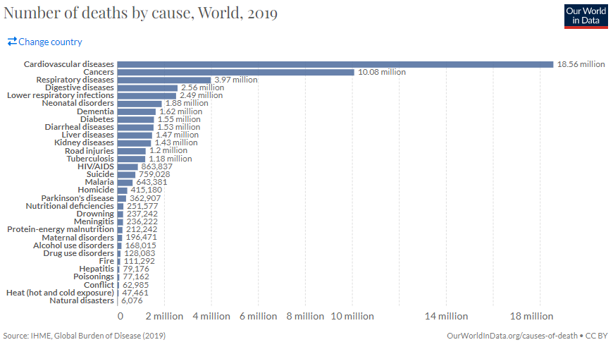
01
Introduction
암은 가장 많은 사람들을 죽게 만드는 원인 중 하나이며, 그 영향력을 키워가고 있다.
- 심혈관 질병 다음으로 주요한 사망 원인이다. [IHME, 2019]
추세를 고려할 때, 암은 21세기 중에 심혈관 질병보다 높은 사망률을 가지게 될 것으로 추측된다. [Fred, 2021]
Graduate School of Data Science
Graduate School of Data Science

Slide 4
01
Introduction
병리학자 공급 부족, 병리학 특성, 추가 업무 증대로 인한 병리학자들의 업무 과중이 심화될 것으로 보인다.
1. 급격한 암 환자 증가 추세와 달리, 병리학자의 공급은 이를 따라가지 못한다.
ASCO는 2025년까지 종양학 서비스에 대한 수요가 42% 이상 증가하는 반면 종양학자의 공급은 28%만 증가할 것으로 추정한다. [ASCO, 2014]
2. 진단해야 할 Specimen이 24시간 생성되는 특성 상 병리학자들의 심각한 업무 과중으로 이어진다[Raymond, 2016]
3. 점차 병리학자들에게 기대되는 역할과 업무가 증가함에 따라 업무가 증가한다.
Professional QA/QI is seen as integral part of a pathologist's duty, but the annual work unit per FTE was increased by 20%. [CAP-ACP, 2014]
In most modern pathology departments, the average consultative workload increases by approximately 5–10% annually[Raymond, 2014]
Graduate School of Data Science
Graduate School of Data Science

Slide 5
01
Introduction
업무 과중은 병리학자의 오진단 가능성을 증대시키는 중대한 문제점이다.
3. 업무 과중은 병리학자의 오진단 가능성을 증가시킨다.
The adverse quality and safety impacts increased sharply when the pathologists worked more than 39 hours/week [RCPA, 2011].
Results The rate of inaccurate diagnoses ranged from 3% to 9% among the different specimen groups. [Martyn, 2018]
Burnout in Iranian SLPs was investigated by Kasbi et al. (2018). Of the 182 participants in the study, 99.7% reported some level of burnout (44% had mild burnout, 53.5% moderate burnout, and 2.2% severe burnout).
Job burnout among Iranian speech and language pathologists.
=> 정도의 차이는 있으나 99.7%의 병리학자들이 번아웃을 경험했다.
One qualitative study added to the literature on burnout. McLaughlin, Lincoln, and Adamson (2008) identified feelings of decreased personal accomplishment (one element of burnout) in their interviewees, which led them to conclude that the SLPs were possibly at risk of developing burnout.
=>
비용 / 업무 만족도 쪽으로 내용을 붙이고 싶다.
업무 과중으로 한번 필터링을 거치는 게 맞을까?
Hutchins et al. (2010) reported that while SLPs were generally satisfied with their jobs, there was a significant negative correlation between caseload size and workload satisfaction specifically.
Retention of school-based SLPs : Relationships among caseload size, workload satisfaction, job satisfaction, and best practice. Communication Disorders Quarterly, 31, 139–154.
Graduate School of Data Science
Graduate School of Data Science
Heritage et al. (2019) reported that a lack of job satisfaction contributed significantly to the intention to leave the profession.
=> 이탈 가능성이 있다.

Slide 6
01
Introduction
Artificial Intelligence (AI) has recently shown great and considerable success in the analysis of medical images.
Deep learning(DL) for pathology [목적 / 상황 설명]
목적 : Computational pathology aims to improve diagnostic accuracy, optimize patient care, and reduce costs by bringing global collaboration. [Miao, 2021]
현황
The development of whole slide scanners enabled the digitization of histopathological process by generating whole slide images (WSI) and facilitating the pathologist's workflow.
With the recent trend of deep learning, more publications are using learning-based methods due to their superior performance (Ibrahim et al., 2020).
프로세스 설명
Annotation -> 모델 학습 ->
Deep learning(DL) 기반의 서포트 시스템은 업무과중을 해소할 뿐만 아니라,
진단 정확도까지 향상시키는 방안으로 기대되고 있다.
AI-based computational pathology as an emerging discipline has recently shown great promise to increase both the accuracy and availability of high-quality health care to patients in many medical fields.
Application of AI in digital tissue--based diagnosis will allow the pathologists to work as supervisors and no longer as primary "water carriers". Its accurate use will give them the time needed to concentrating on difficult cases for the benefit of their patients
AI (artificial intelligence) in histopathology--from image analysis to automated diagnosis.
Klaus Kayser, JĂźrgen GĂśrtler, Milica Bogovac, Aleksandar Bogovac, Torsten Goldmann, Ekkehard Vollmer, Gian Kayser
Graduate School of Data Science
Graduate School of Data Science

Slide 7
01
Introduction
Artificial Intelligence (AI) has recently shown great and considerable success in the analysis of medical images.
Deep learning(DL) for pathology [성과]
성과
Deep learning approaches (e.g., convolutional neural networks [CNNs], see Figure S1 in the Supplementary Materials) have been successfully applied to several tasks, in digital pathology, including image/object segmentation and classification (Chen et al., 2017; Kainz et al., 2015; Malon et al., 2008; Sirinukunwattana et al., 2016).
아래 구조에 맞춰서 Reference 첨가하기.
Study / Object / structure / Traindataset
- Study : 저자-연도
- Object : Anatomy * Classification
- Structure : 모델 구조
- Train dataset : ~~
Graduate School of Data Science
Graduate School of Data Science

Slide 8
02
Problem
의료계에서, 특히 WSI 분야에서 데이터 셋이 Imbalance한 경우가 흔하다.
- 특정 의학적 조건이 드물기 때문에 데이터 세트에서 양성 사례의 수가 음성 사례의 수보다 훨씬 적다. + Stomach 자료 옆에 첨부하기
이름 / WSI - Patch / Imbalance 여부 / 간략한 정보.
[WSI]
BreAst Cancer Histological (BACH) Challenge dataset : publicly available dataset that is used to evaluate the performance of machine learning models in the medical field, specifically in the area of breast cancer histology. The BACH dataset is considered to be imbalanced because the ratio of IC to non-IC pixels is low.
- Imbalance
ICIAR(International Conference on Image Analysis and Recognition) : The dataset contains 400 whole slide images (WSIs) of breast cancer tissue, which have been annotated by pathologists with the goal of identifying and localizing the regions of invasive carcinoma (IC). Imbalance
Camelyon16 :The dataset contains 400 whole slide images (WSIs) of breast cancer tissue, which have been annotated by pathologists with the goal of identifying and localizing the regions of invasive carcinoma (IC). The Camelyon16 dataset is considered to be imbalanced because the ratio of IC to non-IC pixels is low, meaning that there are relatively few positive (IC) examples compared to the negative (non-IC) examples
[Patch]
BreakHIS : The dataset contains 7,909 microscopic images of breast tissue samples, which have been labeled as either benign or malignant. Imbalanced
Graduate School of Data Science
Graduate School of Data Science

Slide 9
02
Problem
Imbalance 데이터셋은 기존의 Classification 방법을 적용시 성능이 악화된다.
대부분의 classification은 balanced class distribution을 가정한다. 그래서 Imbalance 데이터의 특성을 잘 반영하지 못하여 성능이 악화된다[H He, 2009].
Imbalanced data을 기존의 Classification 방법들을 적용했을 때 난항점이 있다.
1. Major class에 의해서 Bias가 생겨서 Minorty Class를 잘 구별하지 못한다 해도 높은 Accuracy을 달성한다[Loyola-Gonalez et al, 2016].
2. Minorty 사례에 대해서 여러 Class에 Overlapping 하는 경우가 잦아 높은 신뢰도를 갖기가 어렵다[Denil, 2010].
3. 이미지 등의 고차원의 데이터에 대해 예측할 경우, Minorty의 패턴을 학습할 정도의 충분한 양의 데이터를 구하기 어렵다[Wasikowski, 2010].
Graduate School of Data Science
Graduate School of Data Science

Slide 10
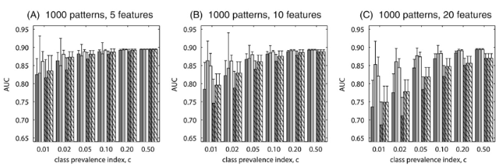
02
Problem
의료 분야에 있어 imbalance 데이터셋 문제는 초기에 해결되지 않으면 심각한 악영향을 초래할 수 있다[Kumar 2021].
The increasing extent of class imbalance in the training data (i.e., reducing positive class prevalence) has an increasingly detrimental effect on the neural network classifier performance. Resampling을 방법을 적용해도 성능이 떨어지는 것을 볼 수 있다.[Maciej, 2008]
Graduate School of Data Science
Graduate School of Data Science

Slide 11
02
Problem
Imbalance 데이터셋에서의 모델 예측 성능 악화를 방지하기 위해 크게 사용하는 방법은 3가지가 있다.
1. Resampling the dataset to oversample the minority class or undersample the majority class
단점 ) 학습용 데이터와 실제 데이터 분포가 달라진다
2. Using techniques such as cost-sensitive learning or class weighting to adjust the learning algorithm
단점 ) 전문가가 개입해야 한다. 적용하기 쉽지 않다.
3. Combining multiple models to make a final prediction
단점 ) 기존의 Framework을 적용하기 어렵다.
Graduate School of Data Science
Graduate School of Data Science

Slide 12


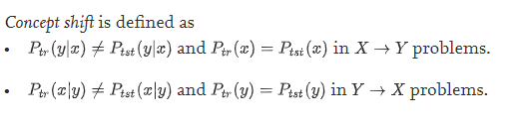
02
Problem
학습용 데이터와 실제 데이터 분포가 다를 시 성능이 악화될 수 있다.
Dataset shift” : cases where the joint distribution of inputs and outputs differs between training and test stage[Quinonero, 2009]
Covariate shift
Prior probability shift
Concept shift
정의 참고 : [Jose, 2012]
=> 우리는 Prior probability shift 에 해당된다.
Graduate School of Data Science
Graduate School of Data Science

Slide 13
02
Problem
Prior shift 발생 시 성능이 악화한다[Ref]
- 찾은 것 같은데 머리에 안 들어온다..
However, it is known that this two-step approach, known as “classify and count”, fails because of domain shift (Forman, 2006; Tasche, 2016).
In order to deal with this problem, several improvements have been proposed under an assumption named prior shift
(Saerens et al., 2002; Forman, 2008; Bella et al., 2010; Barranquero et al., 2015).
Semisupervised learning and active learning, two problems that seem very similar to covariate shift have received much more attention.
=> 없으면 내가 실험을 거쳐서 결과를 제시하자.
Graduate School of Data Science
Graduate School of Data Science

Slide 14
03
Suggest
[제안] : 2 Step Framework 을 제안한다.
[New]1 Step : Anomaly detection을 활용한 Majority 줄이기.
2 Step : Imbalance 가 해소된 데이터에 대해 3 Class-classification 적용
아래 개념도 넣기
Graduate School of Data Science
Graduate School of Data Science

Slide 15
03
Suggest
Anomaly detection 개념 설명
정의 : Anomaly detection 이란?
종류
Anomaly detection은 크게 3 class로 나뉜다.
1. point : 큰 데이터 셋에서 single anomalous point을 구별
2. Collective : 개별로는 Anomaly가 아니지만 집단으로 봤을 때는 맞음
3. Contextual : 문맥에 따라 Abnormal, Normal이 나뉨
Graduate School of Data Science
Graduate School of Data Science

Slide 16
03
Suggest
Anomaly Detection method in medical Field
15년 ~ 21년 간 의료계에 AD를 적용한 45개의 연구가 있었으며, 그 중 21개가 Brain image, 그 외로 Chest X-ray, mammography, OCT 등에 적용했다[Maximilian, 2022].
40% 가량의 연구의 AD 동기는 Labeled training data의 부족.
- 모두 semi / unsupervised 방식으로도 성공적으로 성과를 달성했다고 설명함.
Graduate School of Data Science
Graduate School of Data Science

Slide 17
03
Suggest
제안에 대한 기준 점도 제시하면 좋을 듯
장점 /단점 / 문제 해결 가능 / 기존의 Frame work 적용 가능?
Graduate School of Data Science
Graduate School of Data Science

Slide 18
01
Introduction
[문제점] 기존 연구에서는 잘 다루지 않고 있다. -> 이 말을 할 수 있을까? 기존의 연구 방향을 설명하는게 좋지 않을까?
최근 연구 방향은 크게 4가지이다. [Mohammed, 2022]
A survey on artificial intelligence in histopathology image analysis
1. Histopathology image registration
2. Scarce annotations in digital pathology
3. Uncertainty quantification in digital pathology
4. Explainability in histopathology
추가 문제가 있다. Imbalance 데이터가 많다.
However, the learning-based method requires a set of training images with detailed annotations, which is difficult and time consuming to obtain in histological imaging. Nevertheless, learning-based methods offer more promising results with continuing advancements in medical images using deep learning methods.
Graduate School of Data Science
Graduate School of Data Science

Slide 19
01
Introduction
조직 병리 검사는 암 진단의 표준 방법이다. [Rubin, 2004]
일반 검사
증상 발현
건강 검진
일반 검사
방사선 단순 촬영
혈액 검사, 내시경, 초음파
정상
혹은
질병 의심
정밀 검사
영상 검사
CT / M.R.I.
P.E.T. / 초음파
동위원소 촬영
조직 병리 검사
추정 병기 진단
임시 진단
최종 암 진단
치료 방침 결정
진단 과정 출처 : 우리들 내과의원 홈페이지
Graduate School of Data Science
Graduate School of Data Science

Slide 20
01
Introduction
Artificial Intelligence (AI) has recently shown great and considerable success in the analysis of medical images.
Graduate School of Data Science
Graduate School of Data Science

Slide 21
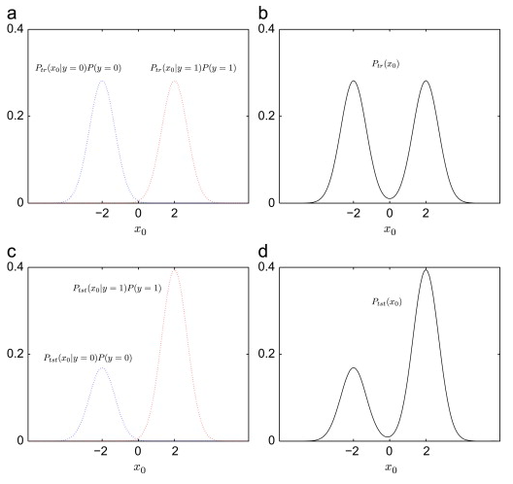
01
Introduction
Prior probability shift
Graduate School of Data Science
Graduate School of Data Science

